Slide 1






THE
BLOOD MANAGEMENT
SYSTEM
Harsh Patel (22000404)
Kaushal Ramoliya (22000409)

Slide 2



WHAT IS A BLOOD MANAGEMENT SYSTEM?
In India, blood banks serve to store and preserve blood for transfusion services.
Blood transfusion is crucial for patients requiring blood or its products.
According to a 2019 MoHFW report, major Indian cities donate around 300,000 units of blood annually.
Blood banks operate at full capacity to meet demand.
Manual processes in many blood banks lead to inefficiencies.
Paper-based systems for donor information and blood inventory management are still prevalent.
Inadequate documentation increases the risk of contaminating blood bags.
Contamination occurs due to incomplete donor records and improper monitoring of blood bags' shelf life.
Implementing a web-based blood bank management system can enhance transfusion safety.

Slide 3
NEED FOR BLOOD BANK MANAGEMENT STSTEM
Blood transfusion safety is a key public health concern in India.
Availability and safety of blood products are vital for maintaining public trust in the healthcare system.
Inadequate availability and unsafe blood products contribute to morbidity and mortality.
Implementing an online blood bank management system is expected to enhance blood transfusion safety.
Risks associated with improper documentation of blood donors and misplaced records can be minimized.
Processes related to blood bag collection, storage, and inventory will be systematized and organized.
Overall, the healthcare management system is expected to improve with the implementation of the online blood bank management system.

Slide 4



PROJECT IMPLEMENTATION
State-controlled platform integrates hospital and blood bank data for streamlined access during emergencies.
Dynamic tracking system monitors donor activity, patient needs, and blood unit availability across the state.
Real-time updates on blood stock levels enable prompt responses to critical situations.
Granular insights into blood availability at city and area levels facilitate targeted resource allocation.
Enhances coordination between healthcare facilities, ensuring timely access to life-saving blood transfusions.

Slide 5
TECHONOLOGIES USED
MySQL
Python
Tkinter

Slide 6
TABLES
Hospital
Blood_Bank
Blood_Bank_Available
Manager
Registration_Team
Donor
Patient

Slide 7
RELATIONSHIPS
Registration_Team to Donor:- One-to-Many
Registration_Team to Patient:- One-to-Many
patient to hospital:- Many-to-One
registration_team to hospital:- Many-to-One
donor to blood_bank:- Many-to-One
hospital to blood_bank:- One-to-One
blood_bank_available to blood_bank:- Many-to-One
manager to bloood_bank:- One-to-Many

Slide 8

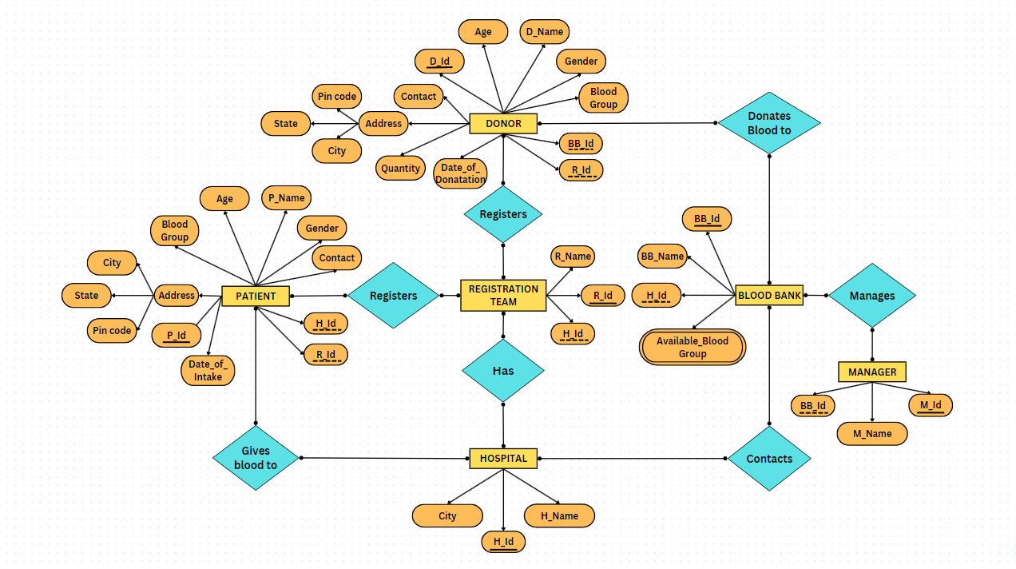

ER-DIAGRAM

Slide 9
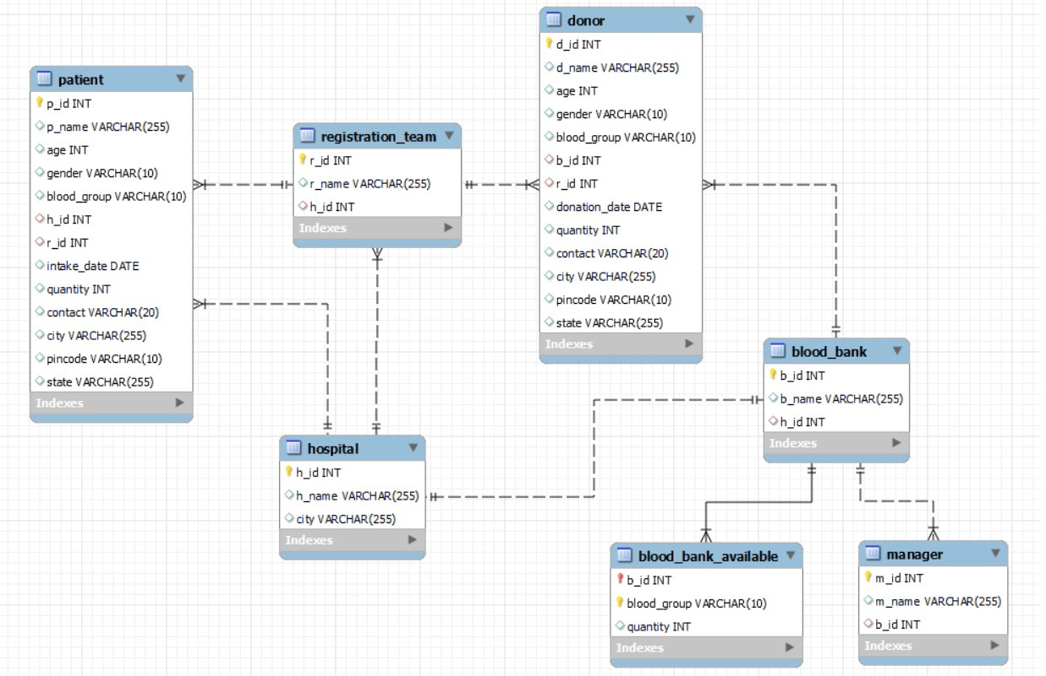
REDUCED TABLE

Slide 10



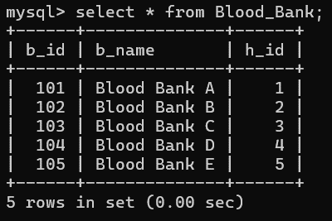
QUERY
Primary Key
foreign key
Create Table Blood_Bank:
Query:-CREATE TABLE Blood_Bank (b_id INT PRIMARY KEY,b_name VARCHAR(255),h_id INT,FOREIGN KEY (h_id) REFERENCES Hospital(h_id) );
Insert Data:-INSERT INTO Blood_Bank (b_id, b_name, h_id) VALUES
(101, 'Blood Bank A', 1),(102, 'Blood Bank B', 2),(103, 'Blood Bank C', 3),
(104, 'Blood Bank D', 4),(105, 'Blood Bank E', 5);

Slide 11
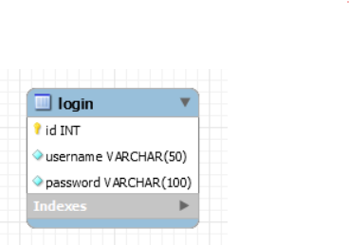


DATABASE SECURITY
User Name
Password
Create Table login :
Query:-CREATE TABLE login ( id INT PRIMARY KEY,username VARCHAR(50) NOT NULL UNIQUE,password VARCHAR(100) NOT NULL);

Slide 12
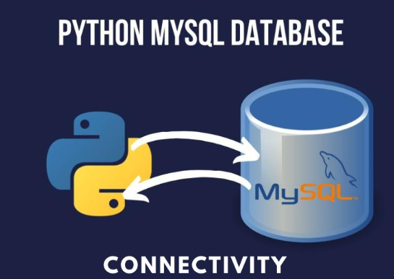
LINKING MYSQL WITH PYTHON
Import mysql. connector.
Establish connection: mysql.connector.connect().
Create a cursor object: connection.cursor().
Perform operations.
Close connection: connection.close().

Slide 13
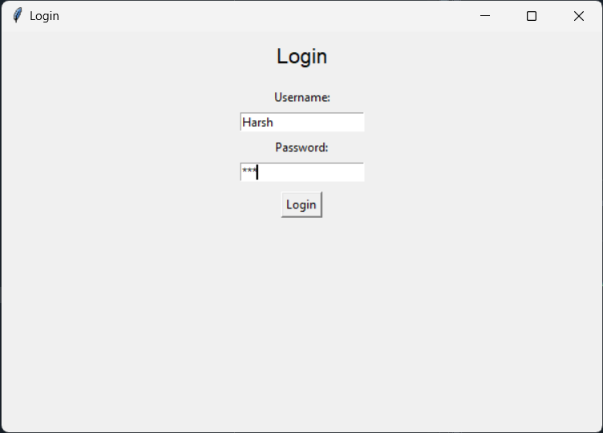
LOGIN

Slide 14
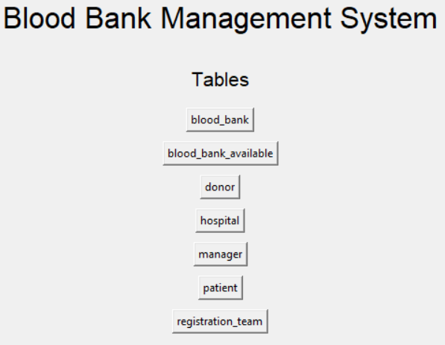
TABLES

Slide 15
LIVEDEMO

Slide 16
THANKYOU

